Slide 1
Tableau Capstone Project
Customer Churn Analysis
Mentor : Jaya Pandey
Student : Siddharth Raj Saxena
Batch : DA22S2

Slide 2
Project Introduction:
Performing customer churn analysis for North America Bank because Credit Card business of this bank is not performing very well.
In spite of growth and transformation over the decades Banking Sector experience Customer Churn.
Customer churn is one of the major challenges for the Banks in the competitive market and a major impact on the financial sector.
Therefore, retaining the existing customers by satisfying their needs.
And proactively engaging with the customers for addressing their complaints should be prioritized for acquiring the trust of the customers.

Slide 3
Description of the Dataset:
Customer Churn Dataset have total rows = 10127 & total columns = 20.
For my analysis, I have considered 5 columns : Attrition Flag, Gender, Region, Card Category & Income Category.
Description of Columns :
Attrition Flag = Customers activity, Existing Customers and Attrited Customers (Churn Customers).
Gender = Male – M | Female – F
Region = Region to which account holder belongs.
Card Category = Type of card (Blue, Silver, Gold & Platinum)
Income Category = Annual Income category of account holder.
Perform Data Pre-Processing before loading the dataset into Tableau.
Display summary statistics
Identify the Total missing values
Treated the missing or null values

Slide 4
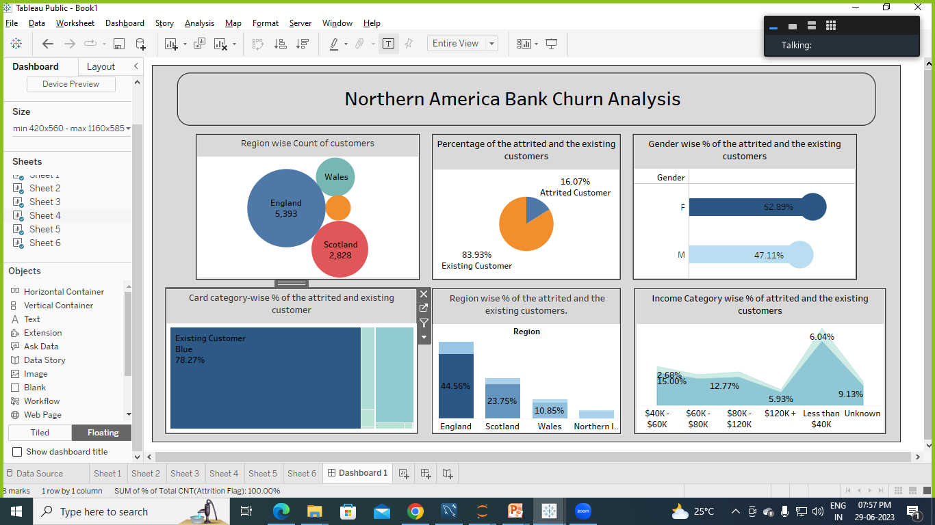
Task 1 : Display the percentage of the attrited and the existing customers from the data.
Conclusion : * Existing Customers are 84%
* Attrited Customers or Churn Customers are 16%

Slide 5
Task 2 : Display Gender wise percentage of the attrited and the existing customers.
Conclusion : * Female Customers are more churn than Male.
* Female (Attrited Customers )= 9.2%

Slide 6
Task 3 : Display Region wise percentage of the attrited and the existing customers.
Conclusion : * Maximum Existing customer = 44.5% and also maximum Attrited Customer = 8.69% are in England.
* Least Attrited Customer = 0.84% in Northern Ireland.

Slide 7
Task 4 : Display the percentage of the attrited and the existing customers for each card category.
Conclusion : * Blue Card Customer are more Churn (Attrited Customer = 15%)
* Platinum Card Customers are least Churn (Attrited Customer = 0.05%)

Slide 8
Task 5 : Display the percentage of the attrited and the existing customers for each income category.
Conclusion : * Maximum Existing and Attrited Customer are available in " Less than $40K " Income Category. Where Existing Customer = 29.12% and Attrited Customer = 6%.
* Less Attrited Customer are in " $120K " income category , where Attrited Customer = 1.24%

Slide 9
Task 6 : Display Region wise count of customers. Identify the region that has the maximum number of customers.
Conclusion : * Bank have maximum number of Customers in England & Count = 5,393
* Bank have minimum number of Customers in Northern Ireland & Count = 568 only.

Slide 10
Conclusion:
Total Churn Customers = 16% (Count = 1627)
Female Customers are more churn (9.2%) than Male. If any new female customer come, there will be high chance of those customers will churn.
Maximum Customer are churn in England Region (8.7%), and least Churn Customers = 0.84% in Northern Ireland. If any new customers come from Northern Ireland there will be less chance of those customers to churn.
Blue Card Customers are more churn (Attrited Customers = 15%). If any customer have Blue Card, there will be high chance to those customers will churn. So proactively engaging with the customers for addressing their complaints should be prioritized.
Maximum Attrited Customers are in “Less than $40K” Income Category (Attrited Customers = 6%), Least Churn Customers are in “$120K” Income Category (Attrited Customers = 1.24%).

Slide 11
Conclusion:
Bank have maximum number of Customers from England (Count = 5,393). So retaining the existing customers by satisfying their needs.
Minimum number of Customers from Northern Ireland (Count = 568). So make more new customers by providing good schemes and offers.
From my analysis, Bank can easily make a decision and retaining the existing customers by satisfying their needs. And proactively engaging with the customers for addressing their complaints should be prioritized for acquiring the trust of the customers.

Slide 12
Thank
You !

